Slide 1
JAVA BASICS
Shekh. Md. Saifur Rahman
Lecturer, Department of CSE,
United International University
Email id: saifur@cse.uiu.ac.bd
Acknowledged: Tanjina Helaly

Slide 2
TOOLS/SET-UP

Slide 3
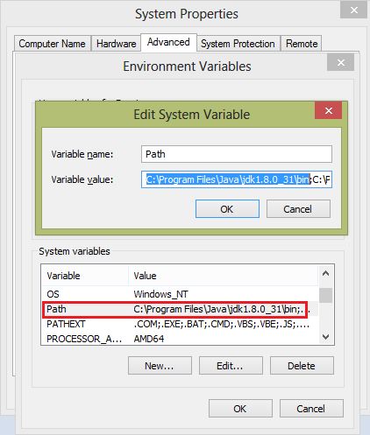
STEP1: INSTALL JAVA AND PATH SET-UP
Need to install Java(JDK and JRE). Get the latest version from Java Standard Edition(SE) from http://www.oracle.com/technetwork
/java/javase/downloads/index.html
After installing Java you need to set-up the “Path” environment variable which is available from My Computer under Advanced Properties tab.
Note: Do not delete anything in “Path” variable. Just add your path “C:\Program Files\Java\jdk1.8.0_31\bin;” (Depending on your version the path will change) at the beginning of the existing value.

Slide 4
STEP 2: INSTALL IDE
Need an IDE: Eclipse or NetBeans or IntelliJ IDEA.
Or
A Text Editor e.g. TextPad
You can install
eclipse from : Eclipse IDE for Java Developers | Eclipse Packages
NetBeans: Apache NetBeans Releases
IntelliJ IDEA: Download IntelliJ IDEA – The Leading Java and Kotlin IDE (jetbrains.com)

Slide 5
COMPILE & RUN JAVA APPLICATION

Slide 6
WITHOUT IDE
Using JDK you can compile and run java
program from command line.
c:> javac HelloWorld. Java
compiling here and
it will produce HelloWorld.class i.e. bytecode.
c:>java HelloWorld
It runs java byte code on native machine

Slide 7
WITH JAVA IDE
Creating, Compiling, Debugging and Execution for these four steps JDK is not user friendly. IDE is provided for that. A list of IDEs are:
Eclipse
Netbeans.
IntelliJ IDEA

Slide 8
DATA TYPES
Divided into two broad categories:
primitive types
class/reference types.
Primitive data : eight types
Logical: boolean (true or false)
doesn’t hold integer (unlike C)
Textual: char (16 bits)
use the Unicode(International: 0-255) not ASCII(1 byte: 0-127)
Integral: byte (8 bits), short (16 bits), int (32 bits), and long (64
bits)
Floating point: float (32 bits) and double (64 bits)
Class or reference data: two types
Textual: String
All classes that declare by yourself

Slide 9
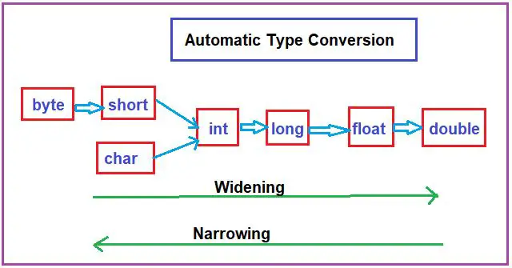
CASTING
Converting from one data type to another.
e.g. assigning an int value to a long variable

Slide 10
CASTING
Converting from one data type to another.
e.g. assigning an int value to a long variable
Example
public class TestCast {
public static void main(String[] args) { byte b= 5;
int a = b;
byte c = a; c = (byte)a; // Casting
float f = 1.2f;
a= f;
a = (int)f; // Explicit Cast
f = a;
}
}

Slide 11
CASTING
Converting from one data type to another.
e.g. assigning an int value to a long variable
Example
public class TestCast {
public static void main(String[] args) { byte b= 5;
int a = b; // OK. Auto Casting
byte c = a; // Compiler error. Need Casting c = (byte)a; // Casting
float f = 1.2f;
a= f; // Compiler error. Need Cast
a = (int)f; // Explicit Cast
f = a;
}
}

Slide 12
OPERATOR
Assignment =
Arithmetic + - * / %
Equality == !=
Relational < <= > >=
Logical &&, ||
increment/decrement ++ --
Shift << >>

Slide 13
ARRAYS
An array is a collection of data items, all of the
same type, accessed using a common name.
The data type can be either a primitive data type or a reference type.
Major differences with C/C++ arrays:
Java arrays are references
Java arrays know their size (length property)
Java multidimensional arrays need not be rectangular
Java array elements are initialized

Slide 14
ARRAY DECLARATION & INITIALIZATION
Declaration
int[] sampleArray; sampleArray = new int[10];
Or
int[] sampleArray = new int[10];
Initialization
During declaration
int[] sampleArray = {1,2,3,4,5};
After declaration
int[] sampleArray;
sampleArray = new int[]{1,2,3,4,5}; sampleArray = {1,2,3,4,5}; // compiler error

Slide 15
ARRAY SIZE & ACCESSING A SPECIFIC
INDEX
Getting size of array
int[] sampleArray = new int[10];
int size = sampleArray.length; //this will return the size of the array, here 10
Accessing a specific item
Assigning a value
sampleArray[0] = 5;
sampleArray[1] = 2;
sampleArray[2] = 3;
Getting/Reading a value
int value = sampleArray[2];

Slide 16
ARRAYS – EXAMPLE CODE
public class ArrayExample
{
public static void main( String args[] )
{
// space to store Reference is allocated, no array space allocated
double[] sampleArray;
//allocate array locations on heap sampleArray = new double[ 10 ];
// Indexing starts at 0 like C/C++
sampleArray[ 0 ] = 5.5;
// Reference refers to new array.
// Old array available for garbage collection
sampleArray = new double[ 2 ];
}
}

Slide 17
MULTI-DIMENSIONAL ARRAY
multidimensional arrays are actually arrays of
arrays.
int twoD[][] = new int[4][5];
Do not need to be rectangular
During creation it’s required to specify the size for the first/leftmost dimension. You can allocate the remaining dimensions separately.
int twoD[][] = new int[4][];

Slide 18
MULTI-DIMENSIONAL ARRAY
 | Rectangular | Irregular Array
Declarion & Array Creation | int twoD[][] = new int[4][5]; or int twoD[][] = new int[4][]; twoD[0] = new int[5]; twoD[1] = new int[5]; twoD[2] = new int[5]; twoD[3] = new int[5]; | int twoD[][] = new int[4][]; twoD[0] = new int[1]; twoD[1] = new int[2]; twoD[2] = new int[3]; twoD[3] = new int[4];
Example of Array | 0 1 2 3 4 5 6 7 8 9 1 1 1 3 4 5 6 7 8 9 | 0 1 2 3 4 5 6 7 8 9

Slide 19
MULTI-DIMENSIONAL ARRAY
Irregular Array
int twoD[][] = new int[4][]; twoD[0] = new int[]{0}; twoD[1] = new int[]{1,2}; twoD[2] = new int[3]{3,4,5}; //error twoD[3] = new int[]{6,7,8,9};
0 1 2 3 4 5 6 7 8 9

Slide 20
CONTROL STATEMENT
if –else
switch
Loop
for
while
do-while

Slide 21
CONTROL STATEMENT
“Enhance for” or “for-each”
automatically cycles through an array in sequence from the lowest index to the highest.
Syntax : for(type itr-var : collection) statement-block
Example:
int nums[] = { 1, 2, 3, 4, 5, 6, 7, 8, 9, 10 };
int sum = 0;
for(int x: nums)
sum += x;
Advantage: Avoid boundary error

Slide 22
Printing MULTI-DIMENSIONAL ARRAY
public static void main( String args[] ) { int twoD[][]={{1,2,3},{5,6}}; for(int[] oneD : twoD){ for(int element : oneD){ System.out.print(element+" "); } System.out.println(); } }

Slide 23
JUMP STATEMENT
break
Exits out of a loop or switch statement
Unlabeled break exits out of the innermost loop or switch
Use labeled break to exit out of nested loops or switch or block.
In case of labeled break program exits from that particular labeled block

Slide 24
JUMP STATEMENT
public class BreakExample {
public static void main( String args[] ) {
for ( int row = 0; row < 5; row++ ) {
System.out.println("Outer loop: " + row);
for (int column = 0; column < 4 ; column++) { System.out.print(column +" ");
if ( ((row + column) % 2 ) == 0 ) {
System.out.println("Break " );
break;
}
}
}
}
}
Output:
Outer loop: 0
0 Break
Outer loop: 1
0 1 Break
Outer loop: 2
0 Break
Outer loop: 3
0 1 Break
Outer loop: 4
0 Break

Slide 25
JUMP STATEMENT – LABELED JUMP
public class BreakExample { public static void main( String args[] ) { Outer: for ( int row = 0; row < 5; row++ ) { System.out.println("Outer loop: " + row); for(int column = 0; column < 4;column++){ System.out.println(column + "\t"); if ( ((row + column) % 2 ) == 0 ) { System.out.println("Break "); break Outer; } } } } }
Output:
Outer loop: 0
0 Break
Program will exit from the labelled block of Outer which contains a nested loop

Slide 26
public static void main(String[] args) { Outer:{ System.out.println("hello"); for (int i = 1; i < 4; i++) { for (int j = 1; j <= i; j++) { System.out.println(i + " " + j); if (i == j) { System.out.println("break "); break Outer; } } } int x = 10; System.out.println(x); } System.out.println("out"); }
Output:
Hello
1 1
break
out

Slide 27
JUMP STATEMENT
continue
A continue statement skips to the end of the current loop's body.
The loop's boolean expression is then evaluated.
Code | Output
public class TestContinue { public static void main(String args[]) { for(int i=0; i<10; i++) { System.out.print(i + " "); if (i%2 == 0) continue; System.out.println(""); } } } | 0 1 2 3 4 5 6 7 8 9

Slide 28
Thank You

